Slide 1
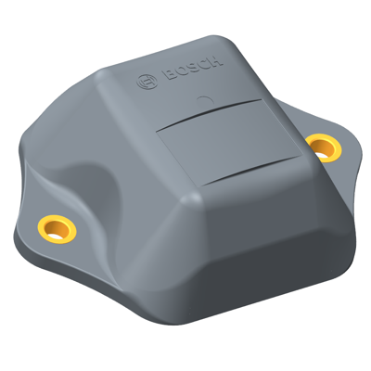





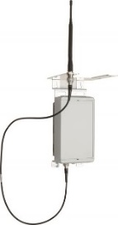

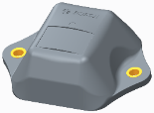


One Pager #BCX18 - TRACI Information for Hackers about TRACI
Which (telemety) data is available?
How to access data?
How to interact with the device or the system?
Access to (telemetry) data via API (REST)
Access to data via WebUI and App
GPS Position of device
Movement status (via acceleration sensor)
Operating hours counter (via acceleration sensor)
Asset name and asset type
Asset picture
TRACI devices and Bluetooth beacons are physically available
Anything else that is important for the hackers?
TRACI-Device has GPS/ acceleration sensor
BLE-Beacon just send its ID, no additional sensors
TRACI
BLE-Beacon

